Slide 1

Introduction to Database Management
Chapter # 01

Slide 2
Objectives
Some common uses of database systems.
The characteristics of file-based systems.
The problems with the file-based approach.
The meaning of the term ‘database’.
The meaning of the term ‘database management system’ (DBMS).
The personnel involved in the DBMS environment.
The advantages and disadvantages of DBMSs

Slide 3
Terms
Database a collection of related data
Data known facts that can be recorded and that have implicit meaning.
(name, telephone numbers and address)
Database Management System(DBMS) the software that manages and controls access to the database
Database application is simply a program that interacts with the database at some point in its execution
Database system to be a collection of application programs that interact with the database along with the DBMS and database itself

Slide 4
Common Examples Of Databases
Purchases from the supermarket
Purchases using your credit card
Booking a holiday at the travel agents
Using the local library
Using the Internet
Studying at university

Slide 5
Traditional File-Based Systems
File-Based Approach
A collection of application programs that perform services for the system end-users such as the production of reports. Each program defines and manages its own data
File-based systems were an early attempt to computerize the manual filing system
The file based system was developed in response to the needs of industry for more efficient data access.
The manual filing system works well while the number of items to be stored is small.
The manual filing system breaks down when we have to cross-reference or process the information in the files

Slide 6
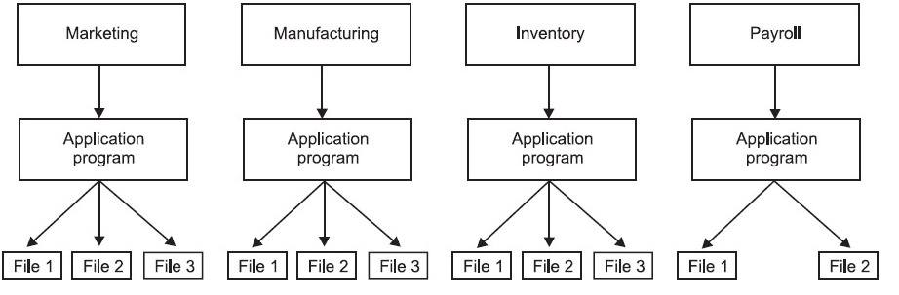
Traditional File-Based Systems

Slide 7
Limitations of the File-Based Approach
Data Redundancy
Since each application has its own data file, the same data may have to be recorded and stored in many files. For example, personal file and payroll file, both contain data on employee name, designation etc. The result is unnecessary duplicate or redundant data items. This redundancy requires additional or higher storage space, costs extra time and money, and requires additional efforts to keep all files up to-date.
Data Inconsistency
Data redundancy leads to data inconsistency especially when data is to be updated. Data inconsistency occurs due to the same data items that appear in more than one file do not get updated simultaneously in each and every file

Slide 8
Limitations of the File-Based Approach
Lack of Data Integration:
Since independent data file exists, users face difficulty in getting information on any ad hoc query that requires accessing the data stored in many files. In such a case complicated programs have to be developed to retrieve data from every file or the users have to manually collect the required information
Program Dependence:
The reports produced by the file processing system are program dependent, which means if any change in the format or structure of data and records in the file is to be made, the programs have to modified correspondingly. Also, a new program will have to be developed to produce a new report

Slide 9
Limitations of the File-Based Approach
Data Dependence:
The Applications/programs in file processing system are data dependent i.e., the file organization, its physical location and retrieval from the storage media are dictated by the requirements of the particular application. For example, in payroll application, the file may be organized on employee records sorted on their last name, which implies that accessing of any employee's record has to be through the last name only.
Poor Data Control:
There was no centralized control at the data element level, hence a traditional file system is decentralized in nature. It could be possible that the data field may have multiple names defined by the different departments of an organization and depending on the file it was in. This situation leads to different meaning of a data field in different context or same meaning for different fields. This causes poor data control.

Slide 10
Database Approach
Database
A shared collection of logically related data, and a description of this data, designed to meet the information needs of an organization
The database is a single, possibly large repository of data that can be used simultaneously by many departments and users
The database is no longer owned by one department but is a shared corporate resource.
The database holds not only the organization’s operational data but also a description of this data
The description of the data is known as the system catalog(or data dictionary or metadata– the ‘data about data’). It is the self-describing nature of a database that provides program–data independence

Slide 11
Database
The definition of data is separated from the application programs
The users of an object see only the external definition and are unaware of how the object is defined and how it functions.
One advantage of this approach, known as data abstraction, is that we can change the internal definition of an object without affecting the users of the object, provided the external definition remains the same.
In the same way, the database approach separates the structure of the data from the application programs and stores it in the database.

Slide 12
The Database Management System (DBMS)
DBMS
A software system that enables users to define, create, maintain, and control access to the database
The DBMS is the software that interacts with the users’ application programs and the database. Typically, a DBMS provides the following facilities
It allows users to define the database, usually through a Data Definition Language(DDL). The DDL allows users to specify the data types and structures and the constraints on the data to be stored in the database
It allows users to insert, update, delete, and retrieve data from the database, usually through a Data Manipulation Language(DML). Having a central repository for all data and data descriptions allows the DML to provide a general inquiry facility to this data, called a query language

Slide 13
The Database Management System (DBMS)
. The most common query language is the Structured Query Language

Slide 14
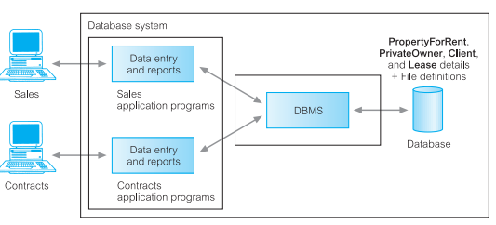
(Database) Application Programs
Application A computer program that interacts with the database by issuing an
program appropriate request (typically an SQL statement) to the DBMS
Users interact with the database through a number of application programs that are used to create and maintain the database and to generate information.

Slide 15
Roles in the Database Environment
Database Administrator
The Chief administrator to oversee and manage these resources.
In database environment primary resource is database it self and secondary resource is database management system
Administering these resources is the responsibility of the database administrator (DBA)
The DBA is responsible for authorizing access to the database, coordinating and monitoring its use, and acquiring software and hardware resources as needed
The DBA is accountable for problems such as security breaches and poor system response time.

Slide 16
Roles in the Database Environment
Database Designers
Database designers are responsible for identifying the data to be stored in the database and for choosing appropriate structures to represent and store this data
It is the responsibility of database designers to communicate with all prospective database users in order to understand their requirements and to create a design that meets these requirements
Database designers typically interact with each potential group of users and develop views of the database that meet the data and processing requirements of these groups.
The final database design must be capable of supporting the requirements of all user groups

Slide 17
Roles in the Database Environment
End users
End users are the people whose jobs require access to the database for querying, updating, and generating reports; the database primarily exists for their use. There are several categories of end users:
Casual end users
Casual end users occasionally access the database, but they may need different information each time. They use a sophisticated database query language to specify their requests and are typically middle- or high-level managers or other occasional browsers

Slide 18
Roles in the Database Environment
Naïve or parametric end users
Naïve or parametric end users make up a sizable portion of database end
users. Their main job function revolves around constantly querying and updating the database, using standard types of queries and updates called
canned transactions—that have been carefully programmed and tested. The tasks that such users perform are varied:
Bank tellers check account balances and post withdrawals and deposits.
Reservation agents for airlines, hotels, and car rental companies check
availability for a given request and make reservations.
Employees at receiving stations for shipping companies enter package
identifications via bar codes and descriptive information through buttons
to update a central database of received and in-transit packages.

Slide 19
Roles in the Database Environment
Sophisticated end users
Sophisticated end users include engineers, scientists, business analysts, and others who thoroughly familiarize themselves with the facilities of the
DBMS in order to implement their own applications to meet their complex
requirements.
Standalone users
Standalone users maintain personal databases by using ready-made program packages that provide easy-to-use menu-based or graphics-based
interfaces. An example is the user of a tax package that stores a variety of personal financial data for tax purposes

Slide 20
Advantages of Using the DBMS Approach
In traditional software development utilizing file processing, every user group maintains its own files for handling its data-processing applications
This redundancy in storing the same data multiple times leads to several problems
  Need to perform a single logical update
  Storage space is wasted when the same data is stored repeatedly
  Files that represent the same data may become inconsistent
In the database approach, the views of different user groups are integrated during database design. Ideally, we should have a database design that stores each logical data item—such as a student’s name or birth date—in only one place in the database
This is known as data normalization, and it ensures consistency and saves storage space

Slide 21
Advantages of Using the DBMS Approach
Control of data redundancy
Traditional file-based systems waste space by storing the same information in more than the database approach attempts to eliminate the redundancy by integrating the files so that multiple copies of the same data are not stored one file.
Data consistency
By eliminating or controlling redundancy, we reduce the risk of inconsistencies occurring If a data item is stored only once in the database, any update to its value has to be performed only once and the new value is available immediately to all users

Slide 22
Advantages of Using the DBMS Approach
More information from the same amount of data
With the integration of the operational data, it may be possible for the organization to derive additional information from the same data
Sharing Of Data
Typically Files are owned by the people or departments that use them. On the other hand, the database belongs to the entire organization and can be shared by all authorized users
Improved data integrity
Database integrity refers to the validity and consistency of stored data. Integrity is usually expressed in terms of constraints, which are consistency rules that the database is not permitted to violate. Constraints may apply to data items within a single record or they may apply to relationships between records

Slide 23
Advantages of Using the DBMS Approach
Improved security
Database security is the protection of the database from unauthorized users. Without suitable security measures, integration makes the data more vulnerable than file-based systems.
Economy of scale
Combining all the organization’s operational data into one database, and creating a set of applications that work on this one source of data, can result in cost savings. In this case, the budget that would normally be allocated to each department for the development and maintenance of its file-based system can be combined, possibly resulting in a lower total cost, leading to an economy of scale

Slide 24
Advantages of Using the DBMS Approach
Increased concurrency
In some file-based systems, if two or more users are allowed to access the same file simultaneously, it is possible that the accesses will interfere with each other, resulting in loss of information or even loss of integrity. Many DBMSs manage concurrent database access and ensure such problems cannot occur

